Slide 1

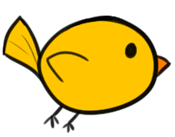
Fly Til You Die
Erina Caferra and Kim Coterwas
4/19/2018

Slide 2
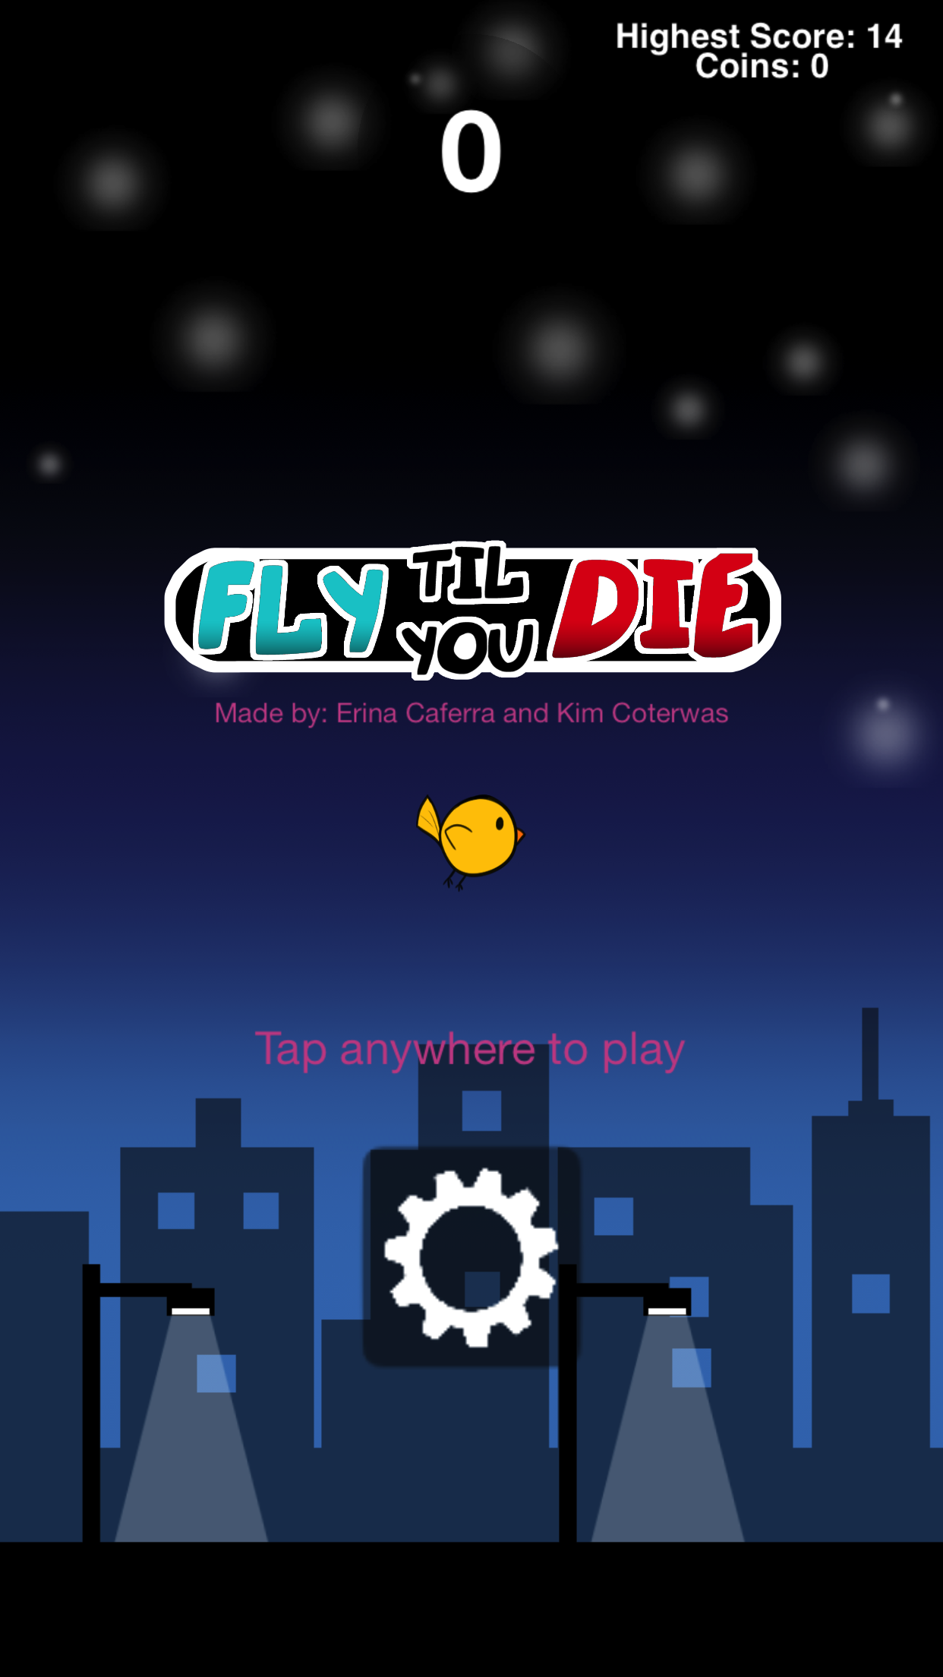
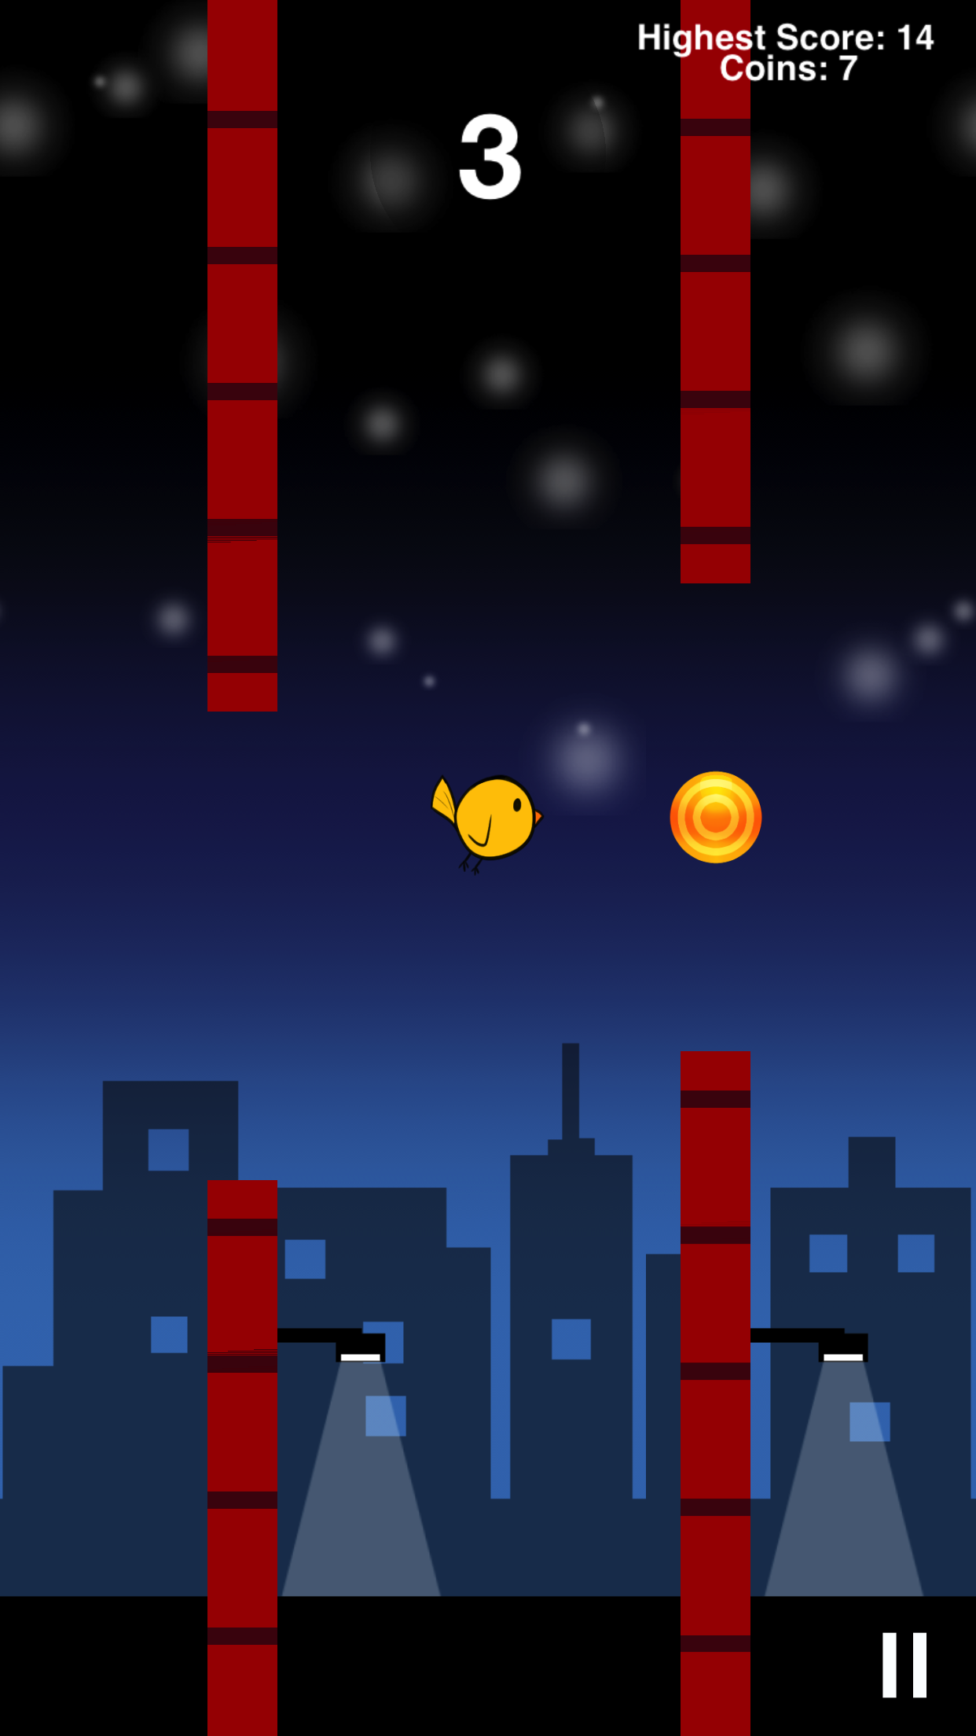
Game Design
Mechanics
Ways to win/lose
Unlockables
Movement
Randomly generated levels

Slide 3
# | Game design | Status | Function
1 | Game Sprites | Done | Sprites for main game (bird, walls, coins)
2 | Unlockable Sprites | Done | Sprites for in-game unlockables
3 | Splash Screen | Done | First screen seen by player
4 | Unlockable functionality | In Progress | Unlockable items for game
5 | Settings Screen | In Progress | Screen to display unlockables for selection
6 | Music | Not Done | New music during gameplay
7 | Sound | In Progress | New sound assets for coins/unlockables
8 | High Score | Done | Display high score
9 | Game functionality | Done | Overall ability to play game

